Slide 1

Remote CARI (rCARI) Validation Study
Burkina Faso Sampling
RAM-N – rCARI Team | May 2024

Slide 2
Objective
Objective is to validate the remote Consolidated Approach for Reporting Indicators of Food Insecurity (rCARI) – Using a survey experiment with stratified sample
Notes:
rCARI useful in emergencies where F2F survey is not feasible
The Challenge with rCARI numbers & methodology is that not it is been validated against CARI or IPC
Though is easily available, results are not globally accepted
rCARI is based on the following modules
Food consumption score
Consumption-based coping strategy (rCSI)
Livelihood coping strategy (usually a shorter version of the original)
Income sources
Changes in income

Slide 3
Inclusion criteria [ADMIN level selection]
Mobile phone penetration
Mobile phone network
Accessibility
Heterogenous in terms AFI
Rural & urban
CARI groups of AFI
These factors informed the final ADMIN selection

Slide 4
Implementation
Burkina Faso
2 ADMIN1 Areas
North & Centro-Nord Prefectures
ADMIN1 Areas
4 ADMIN2 Areas
Boulsa
Guibare
La-Todin & Oula
Admin2 Districts
35-40 ADMIN5 Units Randomly selected
Admin5 Villages/Communities
From each PSU, 125 households were be randomly listed for the study. Final sampled 3000-4000 HHs, randomized into 2 Groups – F2F and Remote Groups.
Sampled Households
CARI Sample
(F2F)
rCARI Sample
(Remote)
Face-2-Face Group and Remote Group will be interviewed simultaneously.

Slide 5
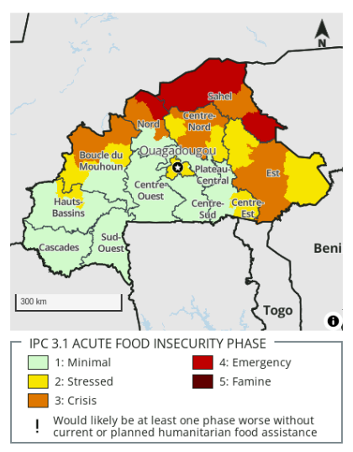
Study areas
Centre-Nord prefecture
Nord prefecture

Slide 6
Selection of Households
Sampling frame = All households in selected ADMIN5 areas
Conduct village census of all selected ADMIN5s
(Trained and conscientious enumerators)
Standardized listing instrument to be used
Collect basic demographic and other HH observable characteristics
Final sampling frame = HHs that have consented to participate during the listing

Slide 7
Selection of Households
Using a confidence level 95%
5% margin of error
Min. sample (2 sample mean test) = 800hh (completed sample at least 400 hh per modality)
Final sample size = 4000HH (2000 hh per modality)
$$Sample Size= \frac{{\left(Z−score\right)}^{2} ×StdDev ×\left(1−StdDev\right)}{{\left(confidence interval\right)}^{2}}$$

Slide 8
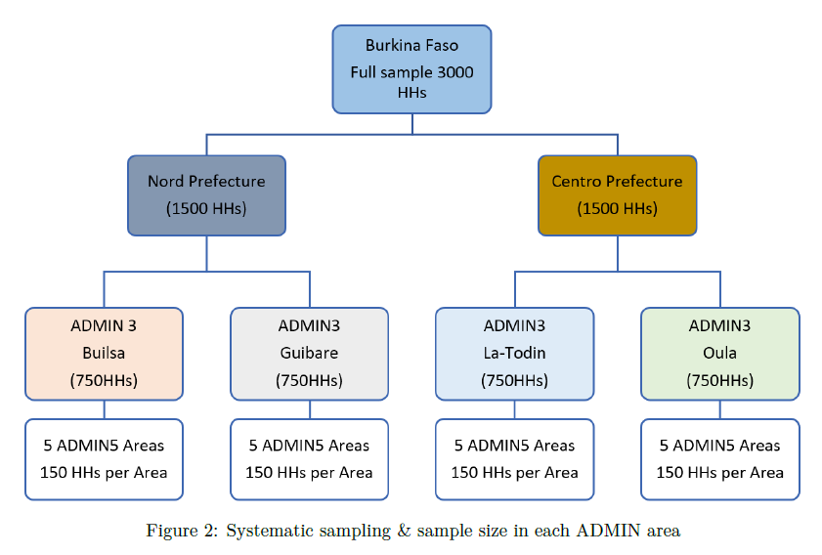
Implementation

Slide 9
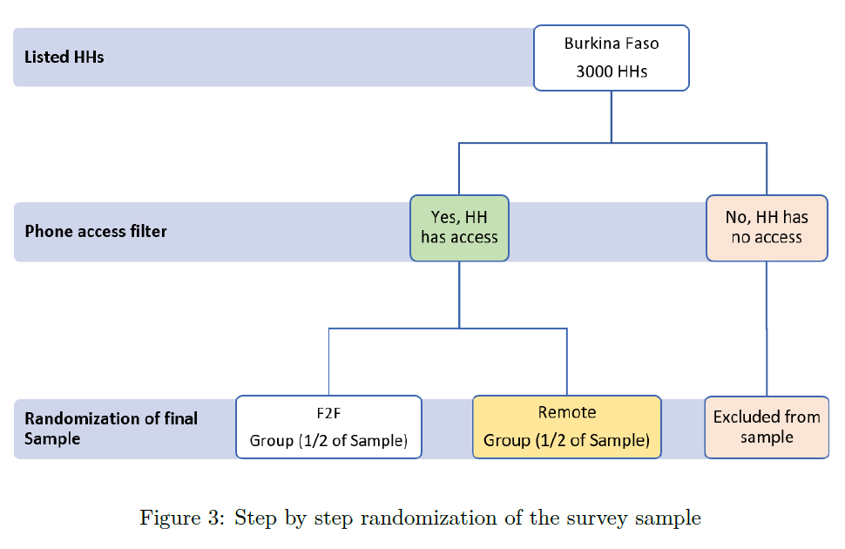
Randomization
Sampled Households

Slide 10
Possible limitations & suggested mitigation strategies
Geographical variation in the distribution of respondents
Study areas will be purposively selected to cater to geographic variations
Enumerator effects (gender, training and motivation)
Consciously hire more females for the remote
At least two enumerators per village
Enumerator assignment will be random (F2F)
High attrition particularly in the remote cohort
Follow strict call protocol

Slide 11
Survey protocols to enhance response rate
Enhanced community engagement & collaboration through local authorities, stakeholders, and opinion leaders at ADMIN5 level
Build trust, support and cooperation
Sensitization during the census/listing phase
Choose their timing of convenience to be interviewed
A comprehensive training on the calling protocol for remote cohort
Introduction
Consent
Questioning techniques
Ethical considerations

Slide 12
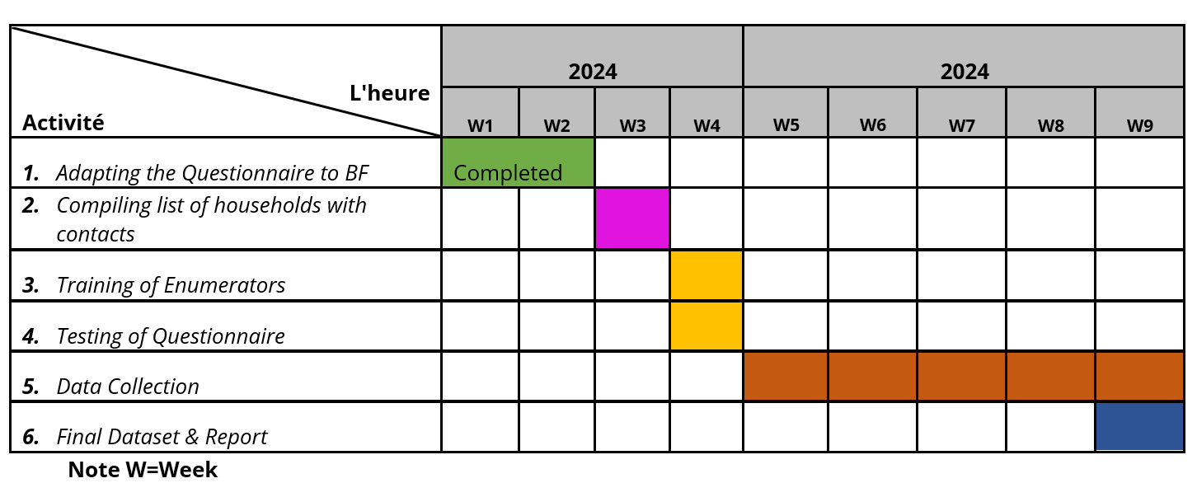
Tentative timelines…

Slide 13
Thank you

